Slide 1


Computational Skills for Researchers
Intro to Quest
Janna Nugent, Sr. Bioinformatics Specialist
Research Computing Services
https://github.com/nuitrcs/intro_quest_workshop

Slide 2


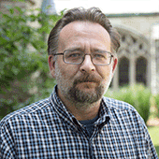


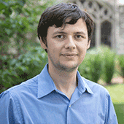


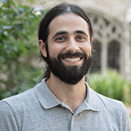
Research Computing: the Consultants
Astronomy
Materials Science
Data Science Support
Bioinformatics
Cloud Computing
Data Workflow
Visualizations
Animations
quest-help@northwestern.edu

Slide 3
Research Computing: the Consultants
We are a team under Northwestern Information Technology with research backgrounds in computer science, astrophysics, materials science, data science, bioinformatics, and modeling and simulation.
quest-help@northwestern.edu

Slide 4
Research Computing: the Consultants
Providing infrastructure, training, and support for:
Computing
Data processing and analysis Bioinformatics pipelines
Data management, sharing, and storage
Software
quest-help@northwestern.edu

Slide 5
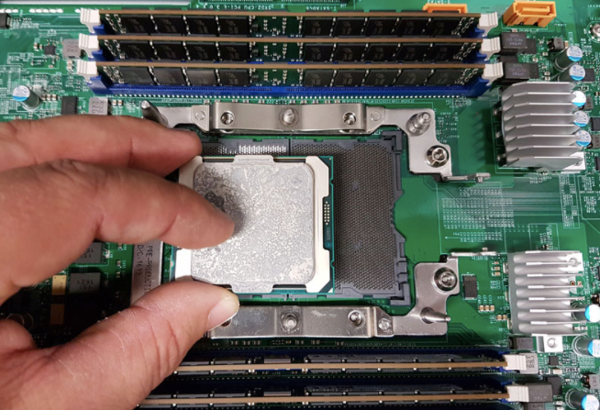
Quest: High Performance Computing Cluster
“node”: a computer
800
“core”: a processor
19,200
Notes:
over 100TB of RAM total

Slide 6

Quest: High Performance Computing Cluster
“infiniband”: high-speed
inter-connect
nodes in racks

Slide 7


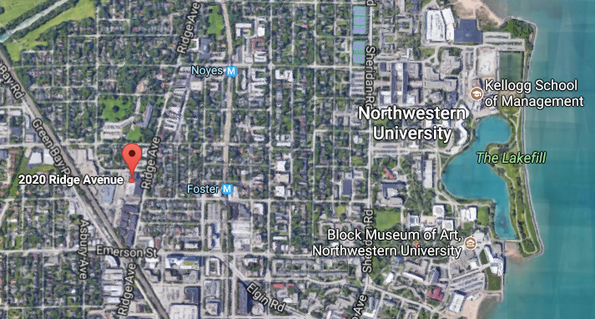
Quest: High Performance Computing Cluster
24 hour on-site security, 3-factor authentication,
firewalls and intrusion detection systems,
dedicated power station, high-throughput network

Slide 8

Quest: High Performance Compute Cluster
Allocation: compute hours, storage space, group
800 compute nodes
3.5 PB
128 GB RAM
/home/netID
Infiniband
/projects/p123
msub
quser10
quser11
quser12
quser13
login nodes
ssh netID@quest.northwestern.edu

Slide 9
Quest: High Performance Computing
Analytics Nodes
The Quest Analytics Nodes allow users to run RStudio and SAS Studio in their web browser, backed by Quest file systems and nodes with more computational resources than available on a personal computer. They are available to all Quest users with an active allocation.

Slide 10
Quest: High Performance Computing
Backing up your data
Northwestern Box: unlimited, free, 15GB single file limit
RDSS & FSMRESfiles
Amazon AWS

Slide 11
Quest: High Performance Computing
ACTIVITY

Slide 12
Quest: High Performance Computing
Parallel Computing
Multiple jobs working independently
“embarrassingly parallel”
“pleasingly parallel”
high-throughput computing
Single job communicating across nodes
message passing:
MPI, OpenMP

Slide 13
Quest: High Performance Computing Cluster
Software
https://kb.northwestern.edu/quest-software

Slide 14
Quest: Logging in and Getting started
Mac users: launch the Terminal App:
ssh <netID>@quest.it.northwestern.edu
PC users: launch PuTTY (preferred) or FastX:
Hostname : quest.it.northwestern.edu
Username : your Northwestern NetID
Password : your Northwestern NetID password

Slide 15
Quest: Logging in and Getting started
login to Quest
$ssh quest.northwestern.edu
2) where are you?
$pwd -> this is your home directory
3) what is the name of your project allocation?
$groups (your project is in /projects/<allocation>)
4) what is the status of your project?
$checkproject <allocation>
5) how much space is used in your home dir?
$homedu

Slide 16
Quest: Getting started with Cyberduck
To connect to Quest, start Cyberduck and then :
1) Click Open Connection in the upper left of the Cyberduck window
At the top of the Open Connection window that appears, Select SFTP (SSH File Transfer Protocol) from the drop-down menu.
2) Enter quest.it.northwestern.edu for server specification
3) Enter your NetID in the Username: box and leave the Password: box empty to prevent your NetID password from being saved in a file on your personal computer. Public Key Authentication is not supported.
4) Click Connect. You will see a Login failed window.
5) Enter your NetID password in the Password: field.
6) Click Login.​

Slide 17
Quest: transfer intro.tar with Cyberduck
On your local machine
locate your intro.tar file in your Downloads directory
Drag intro.tar into your home directory in Cyberduck
On the command line window that’s logged into Quest
$ ls confirm intro.tar is in the directory that you are in
$ tar xvf intro.tar to unpack the tar file
$ ls look for the unpacked files “submit_generic.sh” and “helloworld.py”
$ cat submit_generic.sh take a look at the header of this file

Slide 18
Quest: submit_generic.sh
#!/bin/bash
#MSUB -A <allocationID> ## <-- EDIT THIS TO BE YOUR ALLOCATION
#MSUB -q <queue_type> ## <-- EDIT THIS TO BE YOUR QUEUE NAME
#MSUB -l nodes=1:ppn=1
#MSUB -l walltime=00:10:00
#MSUB -N sample_job
#MSUB -o outlog
#MSUB -e errlog
cd $PBS_O_WORKDIR ## the directory from which the job was submitted
module load python ## Load necessary modules (software pr libraries)
python helloworld.py ## Run the program

Slide 19


Quest: submitting a job
login node
compute node
“msub submit.sh”
compute node
compute node
scheduler
compute node
#MSUB -A <allocationID>
#MSUB -q <queue_type>
#MSUB -l nodes=1:ppn=1
#MSUB -l walltime=00:10:00
compute node

Slide 20
Quest: sample bash submission script
What is the scheduler looking for in your script?
Behold, this is a BASH script:
#!/bin/bash
#MSUB -A p20XXX
#MSUB -q short
#MSUB -l nodes=1:ppn=6
#MSUB -l walltime=04:00:00
#MSUB -N projectname_mysoftware
#MSUB -o outlog
#MSUB -e errlog
Account:
Queue:
Number of nodes & cores:
Length of the job:
Name the job:
Generate an output log:
Generate an error log:

Slide 21

text editor: nano
$ nano submit_generic.sh this will open the named file for editing or create it if it doesn’t exist
type your text: the mouse will not move the cursor - navigate with the arrow keys
save and quit: commands are on the bottom of the screen - the “^” stands for “control”

Slide 22
Quest: sample bash submission script
submit your job
$msub submit_generic.sh
2) copy the job_id msub returns
3) where is your job in the queue?
$showq -u <your netID>
4) what is the status of your job?
$checkjob <job_id>

Slide 23
Quest: sample bash submission script
Jobs on Quest
https://kb.northwestern.edu/page.php?id=69247
Example Jobs
https://kb.northwestern.edu/page.php?id=70719

Slide 24
Questions?
email: quest-help@northwestern.edu
Research Computing Services

